Slide 1
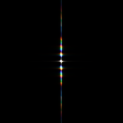
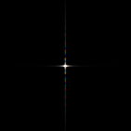
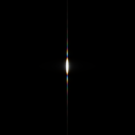

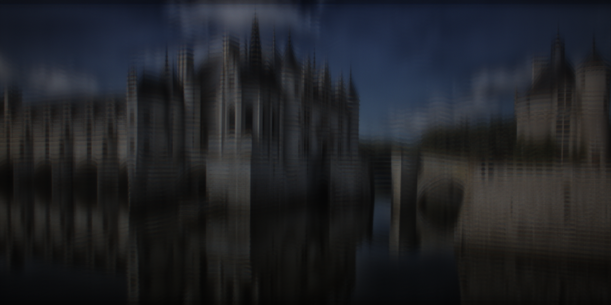
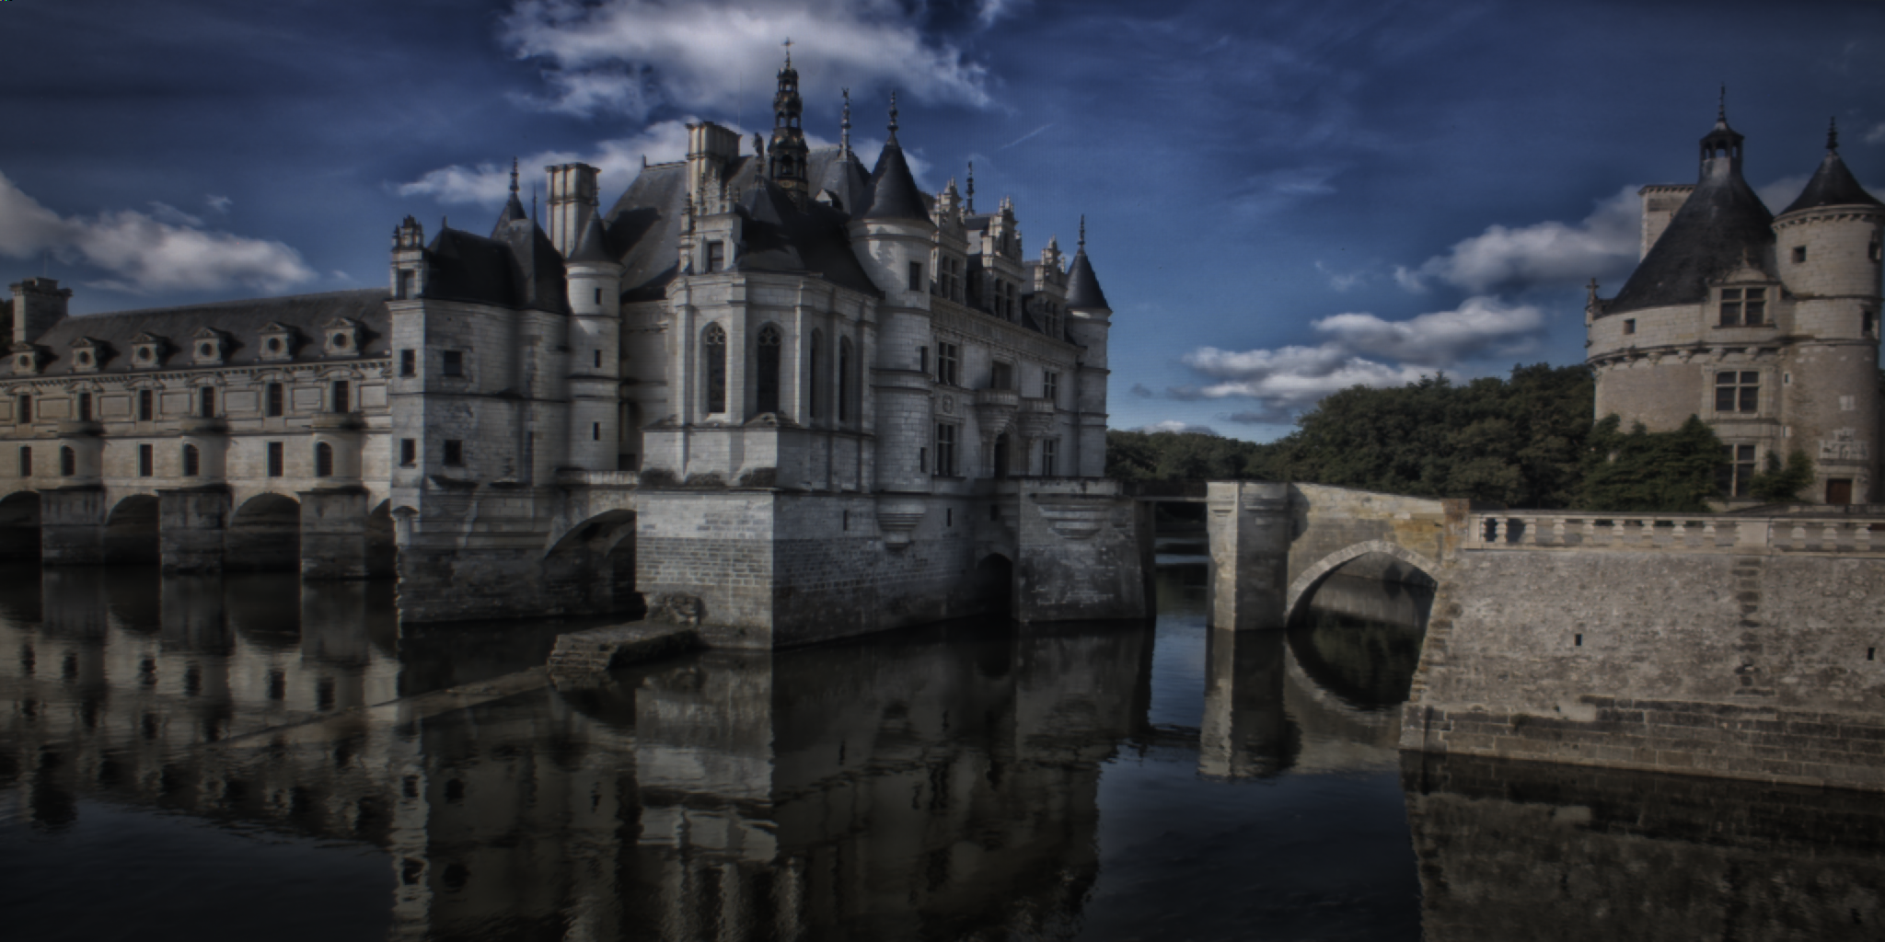
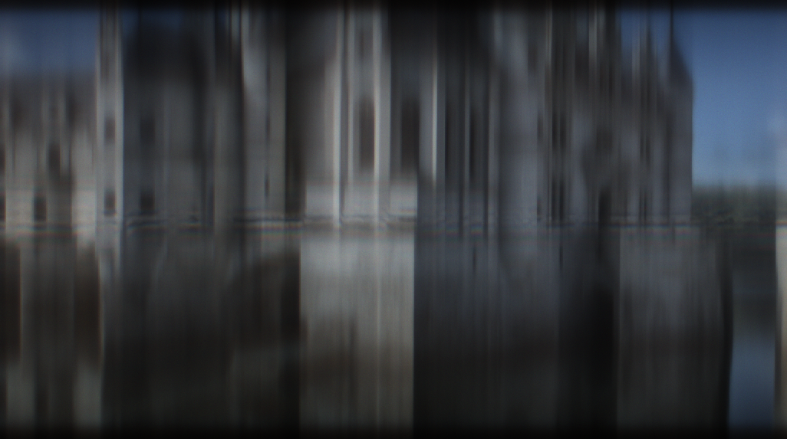
setup
display
lens
sensor
PSFs
captured
(a) TOLED
(b) TOLED + MLA (optimized)
(c) Conventional Camera

Slide 2
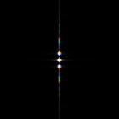
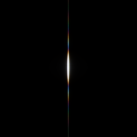
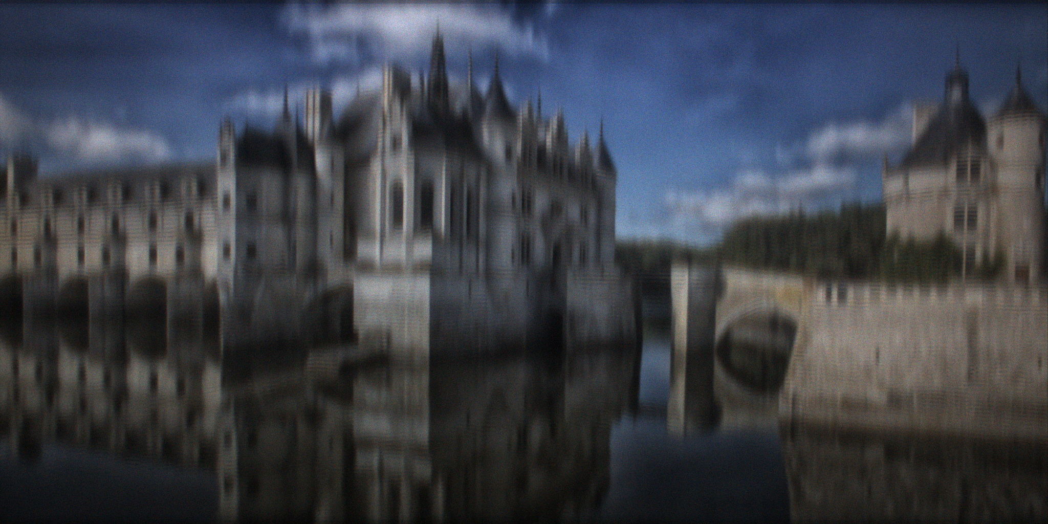
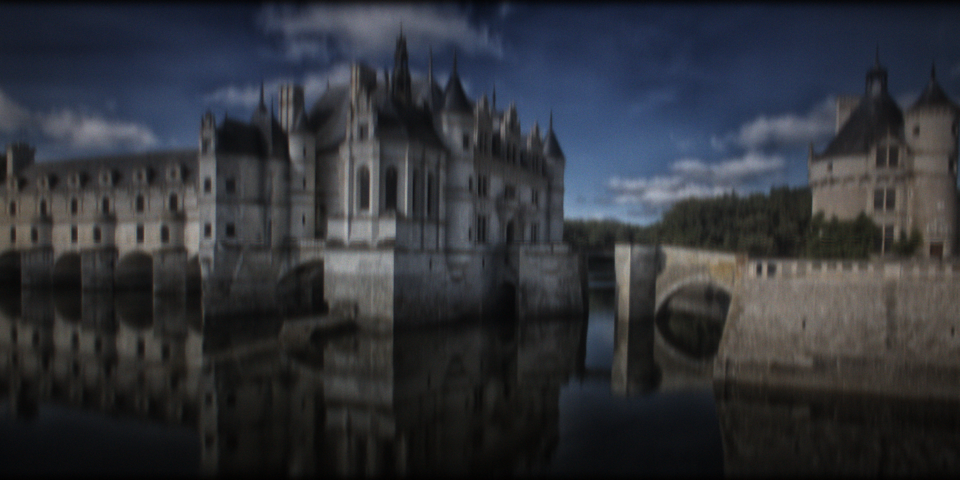
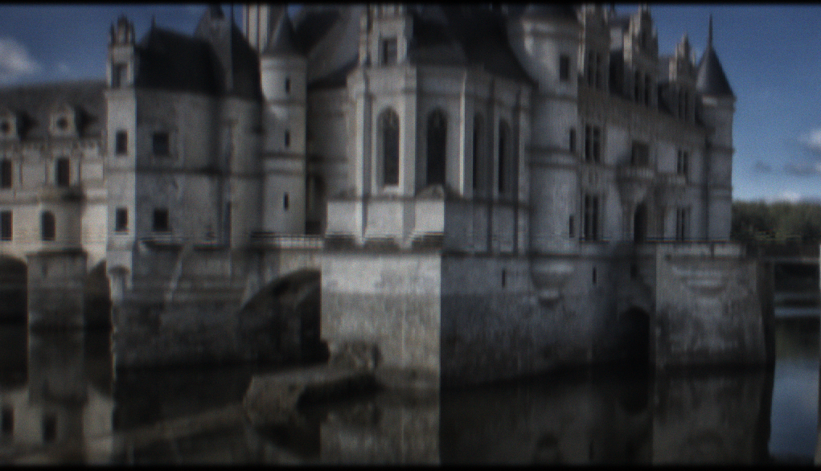
setup
display
lens
sensor
PSFs
captured
(a) TOLED
(b) TOLED + MLA 2x
(c) TOLED + MLA 4x
(d) Conventional Camera

Slide 3

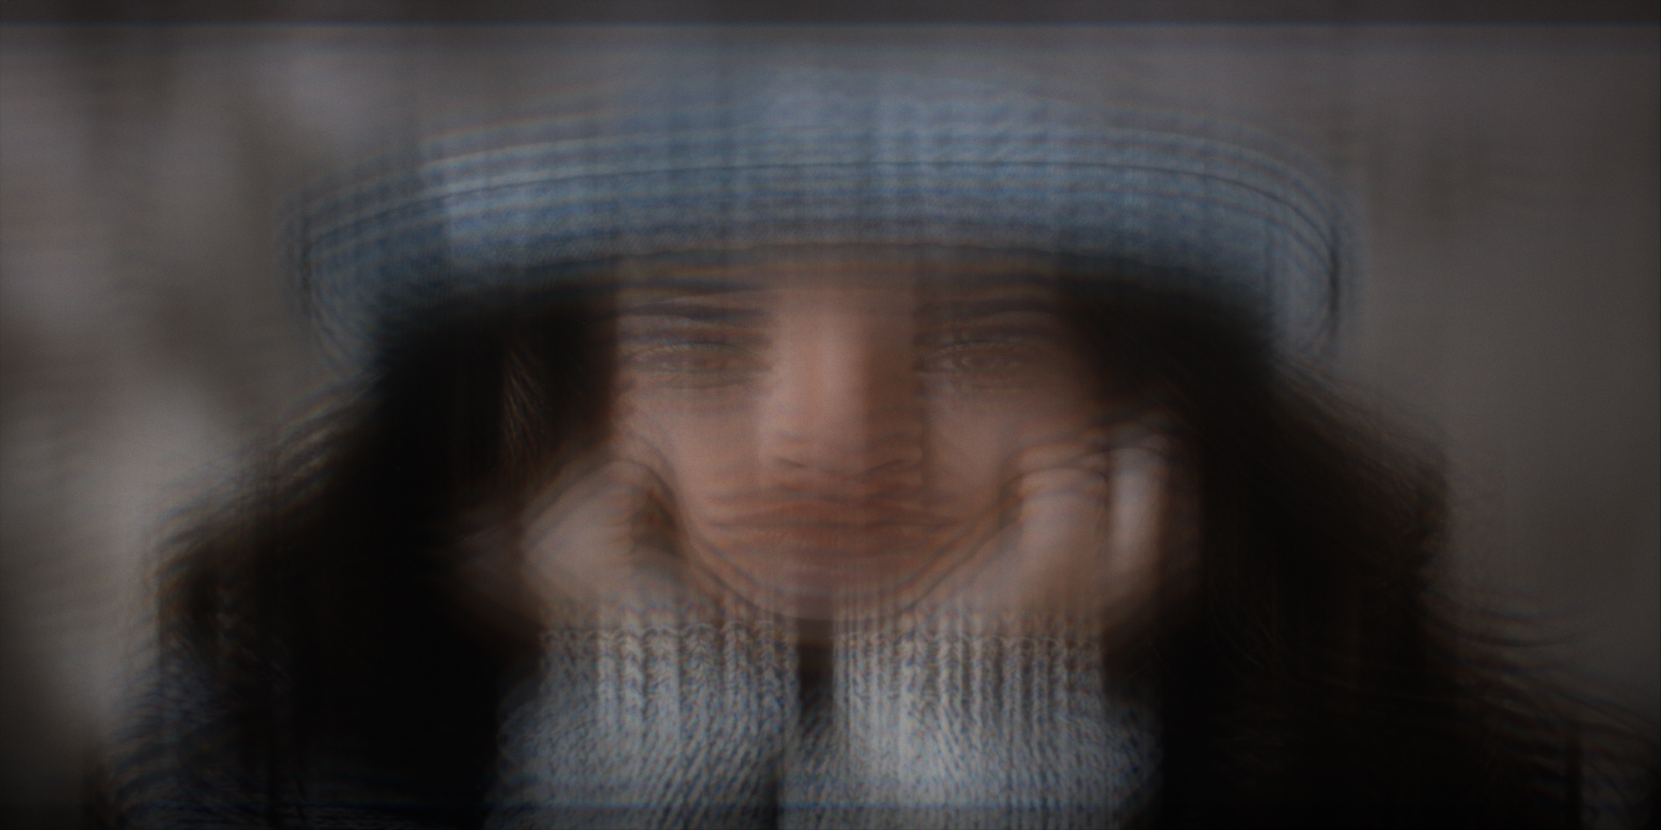
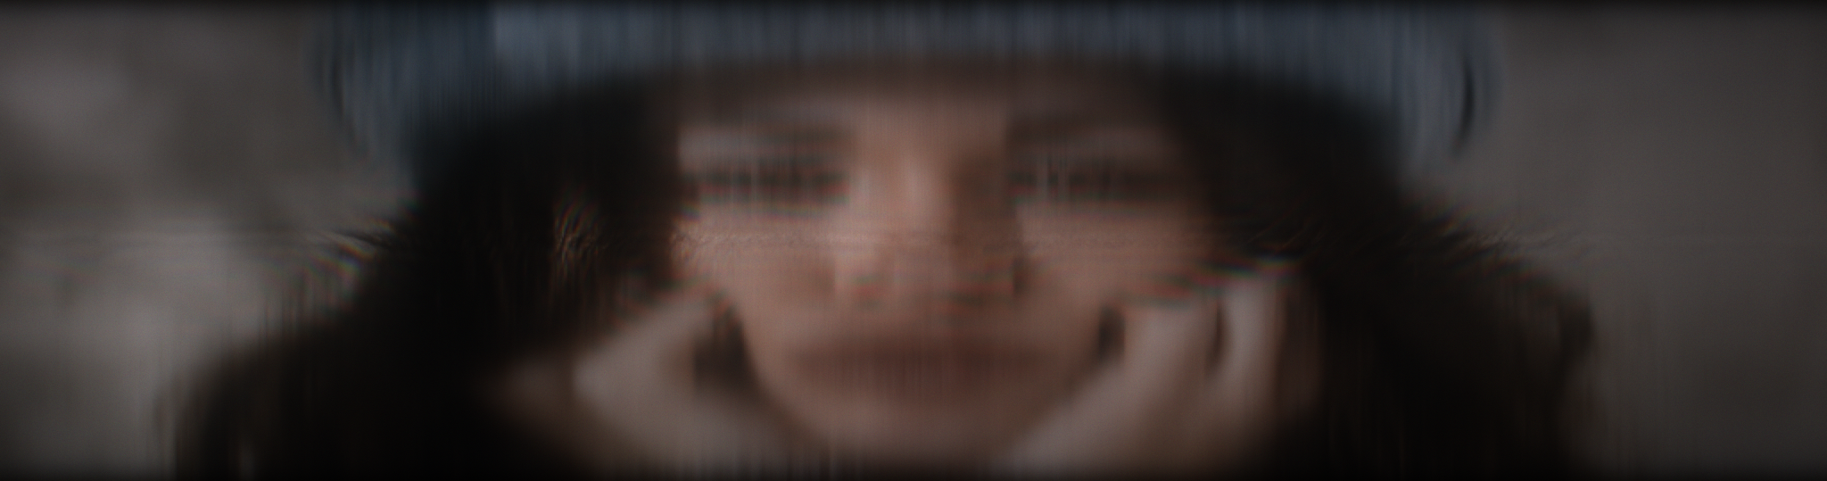
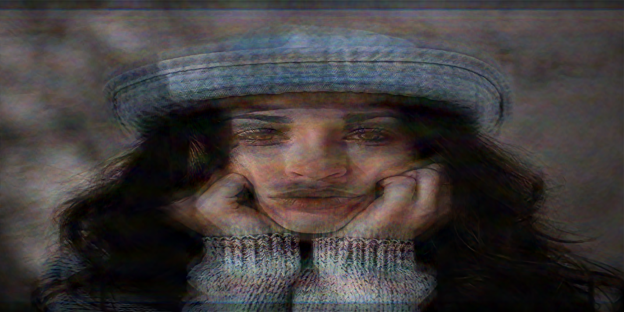
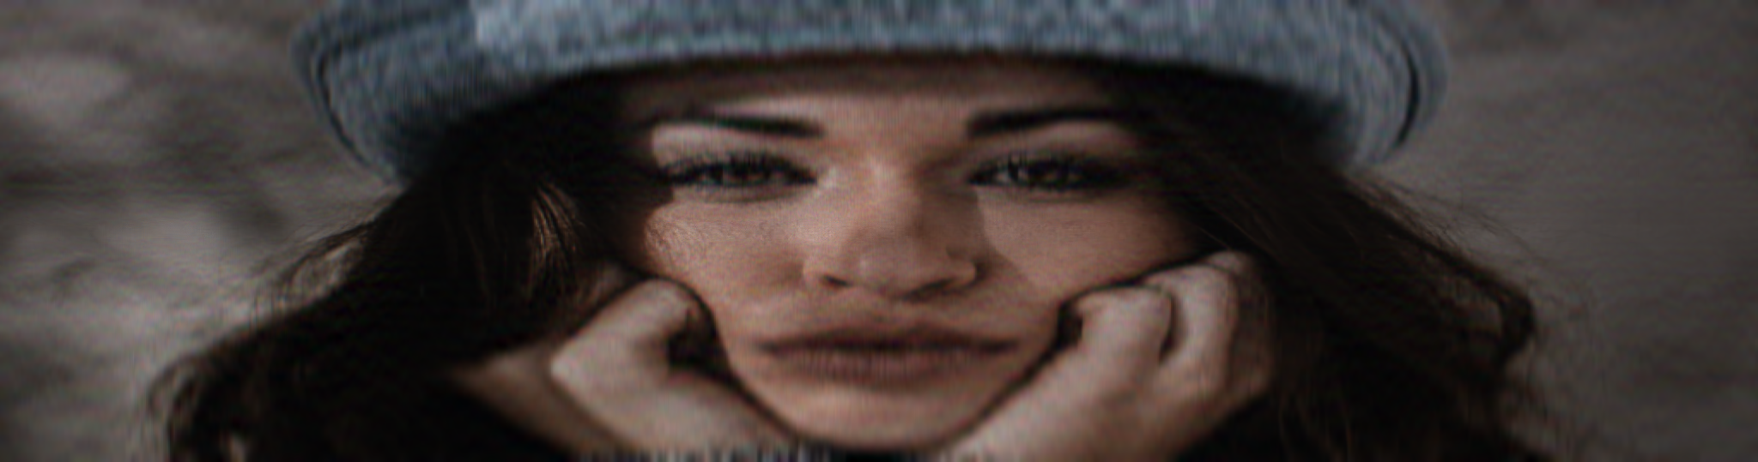
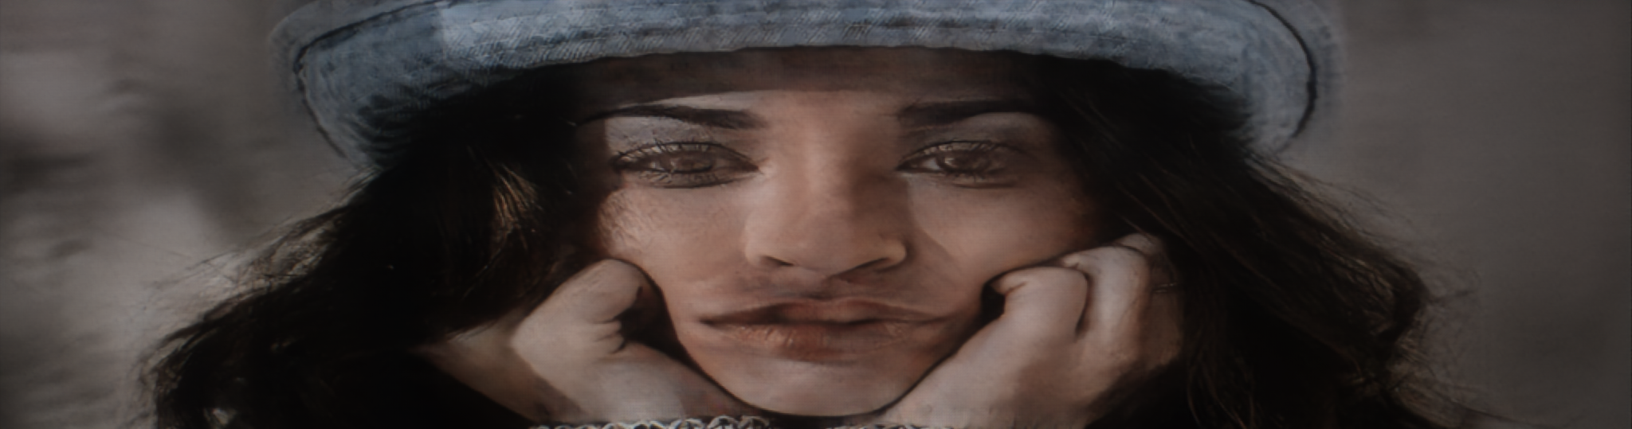
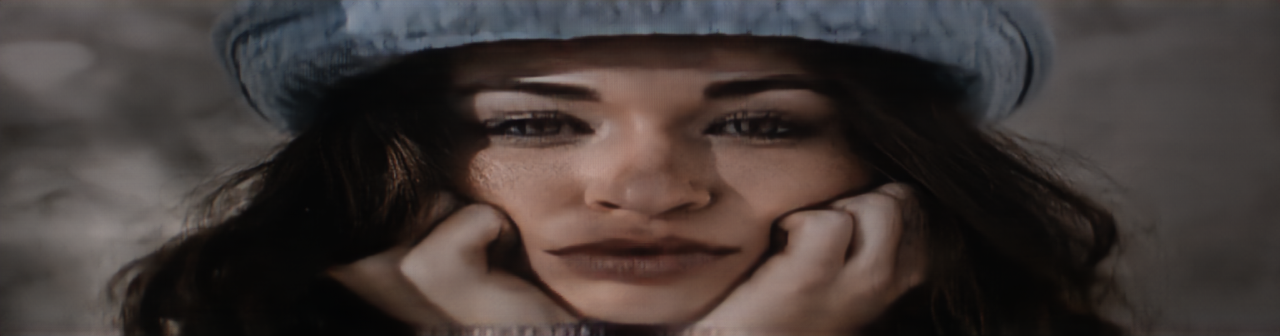
TOLED
pattern
display
lens
sensor
phase masks
(a)
(b)
Captured
Naïve restored
25.09 / 0.8354
32.19 / 0.9306
SOTA restored
27.46 / 0.9398
31.48 / 0.9447
(a) TOLED
(b) TOLED + Phase Masks

Slide 4

(c) Conventional Camera

Slide 5
wo./
w/ Phase Mask

